Slide 1
Fuzzing PANDAS
Data frame sort values
Hector Acosta - 2022427831

Slide 2






Target System
Notes:
pandas is an important tool for AI and data science in general. It is a Python library that provides high-performance data manipulation and analysis tools for structured data. Some of the main features of pandas include:
Data manipulation
Data analysis
Data visualization
Data integration
In AI, pandas is often used for data preprocessing and data cleaning, which are important steps in the data pipeline. Data scientists and machine learning engineers use pandas to load, clean, and transform data into a format suitable for building and training AI models. Overall, pandas is an essential tool for anyone working with structured data in Python.

Slide 3
MOTIVATION + Objective
Target domain: Artifitial inteligence
Incentive: Is an important tool for AI and data science
Importance: A significant proportion of AI projects makes use of Pandas supported by prominent companies
Objectives: Identify defects and enhance efficiency
Notes:
pandas is an important tool for AI and data science in general. It is a Python library that provides high-performance data manipulation and analysis tools for structured data. Some of the main features of pandas include:
Data manipulation
Data analysis
Data visualization
Data integration
In AI, pandas is often used for data preprocessing and data cleaning, which are important steps in the data pipeline. Data scientists and machine learning engineers use pandas to load, clean, and transform data into a format suitable for building and training AI models. Overall, pandas is an essential tool for anyone working with structured data in Python.

Slide 4
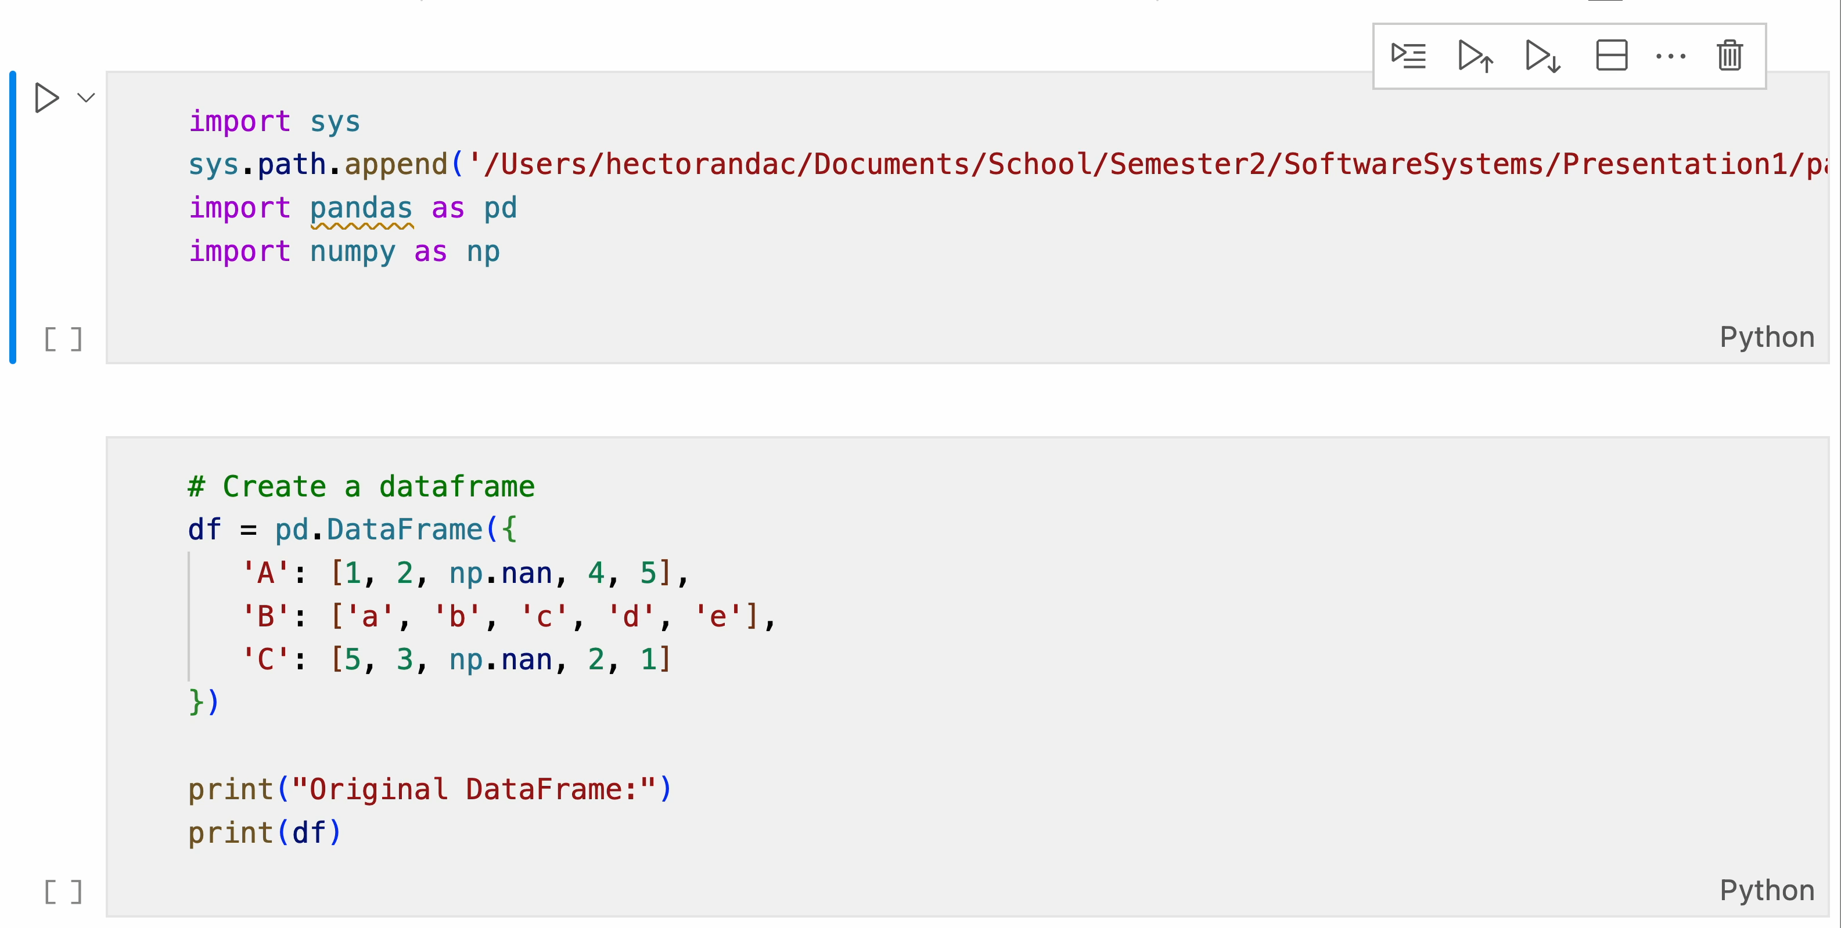
sort_values in data frames
by: Column(s) to sort by.
axis: 0 (sort by row value) or 1 (sort by column value).
ascending: True (ascending order) or False (descending order).
inplace: True (sort original DataFrame) or False (return new sorted DataFrame).
kind: Sorting algorithm: 'quicksort', 'mergesort', 'heapsort'.
na_position: Position of NA values: 'first' or 'last’.
ignore_index: True (reset index) or False (keep original index).
key: A function that gets applied to the values before sorting.

Slide 5
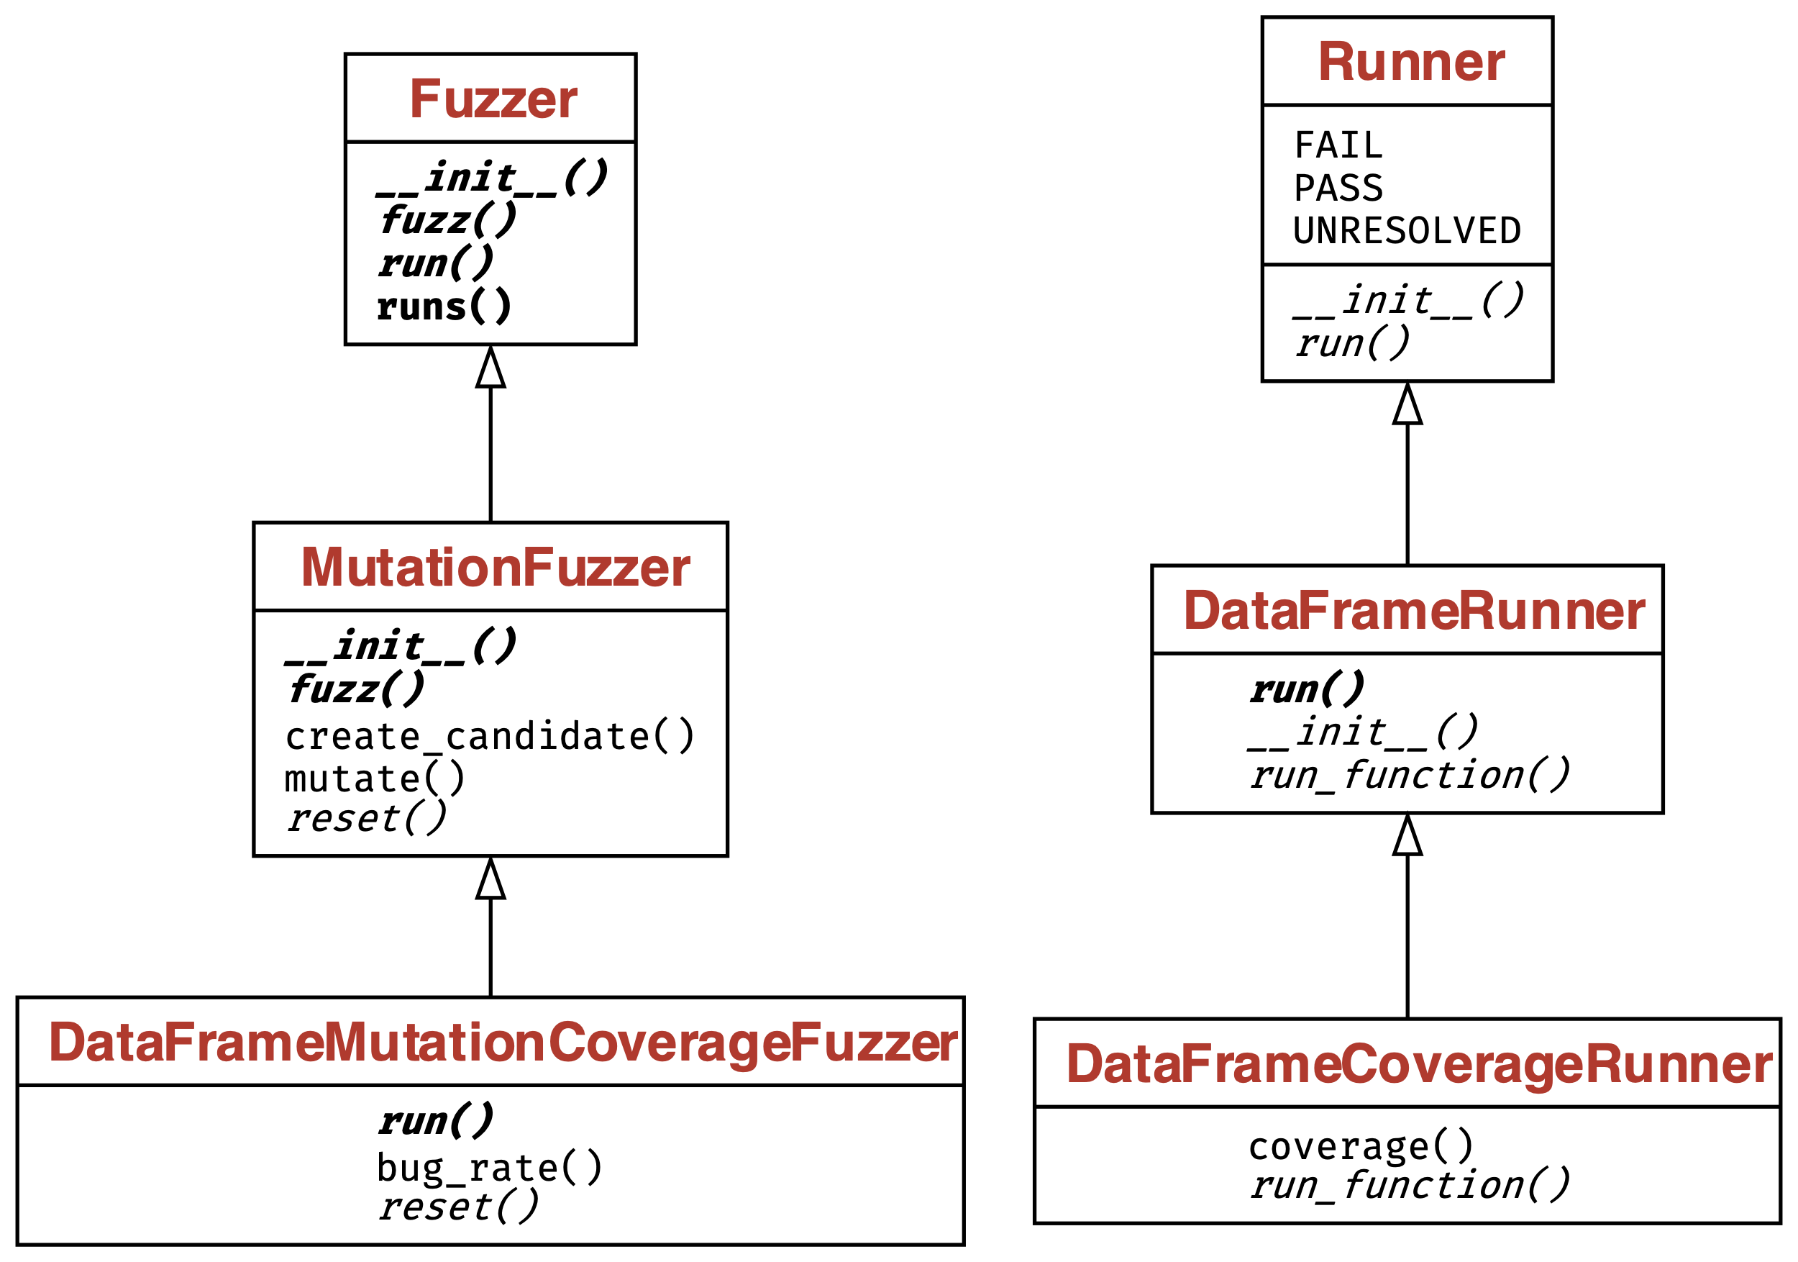
HOW TO RUN – Overview
Create DataFrame Runner that inherits from Base Runner Implementation (DataFrameRunner)
Create Coverage Runner that inherits from DataFrame Runner (DataFrameCoverageRunner)
Create Mutation Fuzzer that inherits from Fuzzer (MutationFuzzer)
Combine both DataFrameCoverageRunner and MutationFuzzer into DataFrameMutationCoverageFuzzer
---------------------------------------------------
In each run, it utilizes the DataFrameCoverageRunner to execute the target function with the fuzzed input and monitor the code coverage, and uses the MutationFuzzer to generate new, possibly unique, inputs (fuzzed input) through mutation of the initial inputs.

Slide 6
HOW TO RUN – INPUT
Attribute/Method | Type | Description
__init__() | Method | Initializes the DataFrameMethodArgs object with a DataFrame, arguments list, and keyword arguments dictionary
mutate() | Method | Applies random mutations to the DataFrame and keyword arguments
__str__() | Method | Returns a string representation of the DataFrameMethodArgs object
df | Attribute | The DataFrame to be mutated
args | Attribute | List of positional arguments (unused in the current implementation)
kwargs | Attribute | Dictionary of keyword arguments that control the sorting behavior of the DataFrame
DataFrame
Arguments
Mutable Input

Slide 7
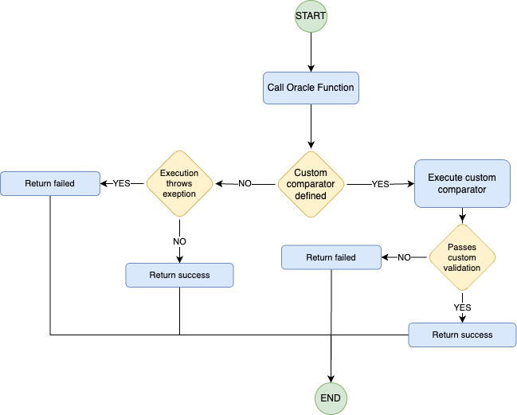
HOW TO RUN – Oracle
Function Oracle(test_output,
expected_output,
comparator = defaultComparator):
If test_output has an Error:
Return False
Else If comparator is not defaultComparator:
If comparator(test_output, expected_output) is True:
Return True
Else:
Return False
Else:
Return True

Slide 8
HOW TO RUN – COST
Function avg_time_per_cycle:
1. If the list of cycle times is not empty:
1.1. Calculate the sum of all cycle times.
1.2. Divide the sum by the number of cycle times to get the average.
1.3. Return the average.
2. If the list of cycle times is empty:
2.1. Return 0.0

Slide 9
How to guide your fuzzer?

Slide 10
Metrics OBTAINED
Coverage
Bug Discovery Rate
Average time per cycle
CPU / Memory Usage

